Slide 1
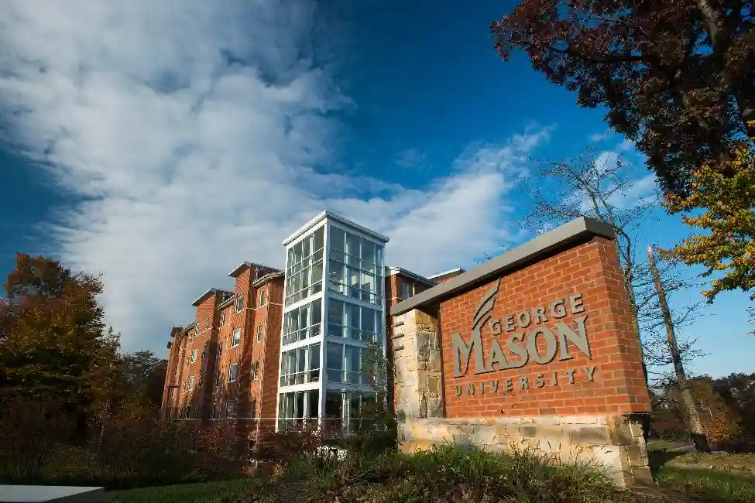
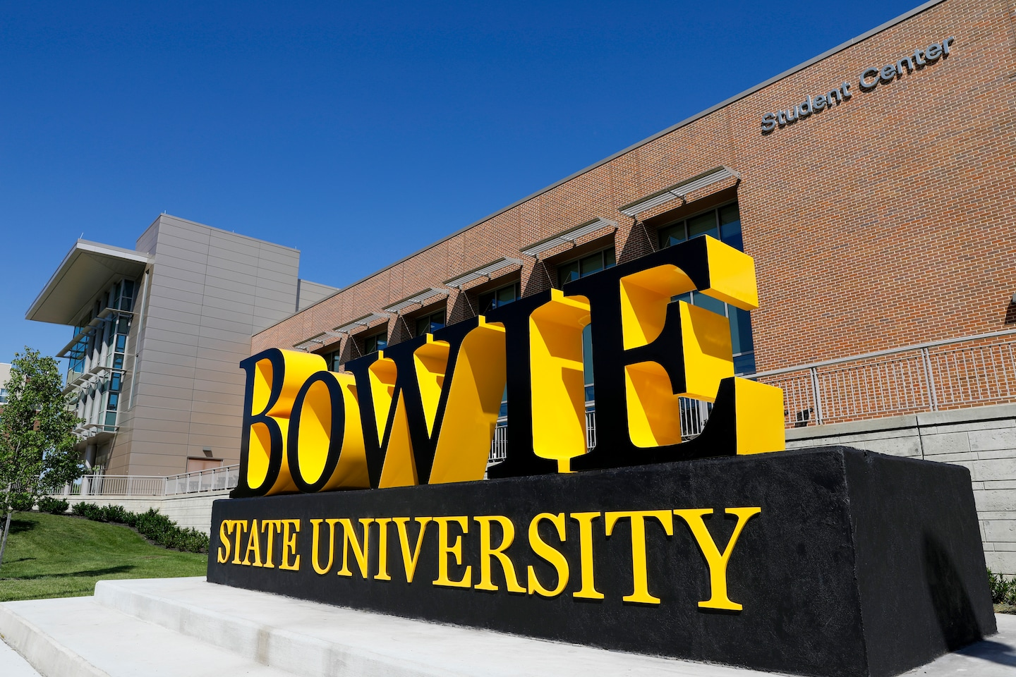
Quantum Pathways: Workshop on Quantum Information Science and Engineering April 12, 2024

Slide 2

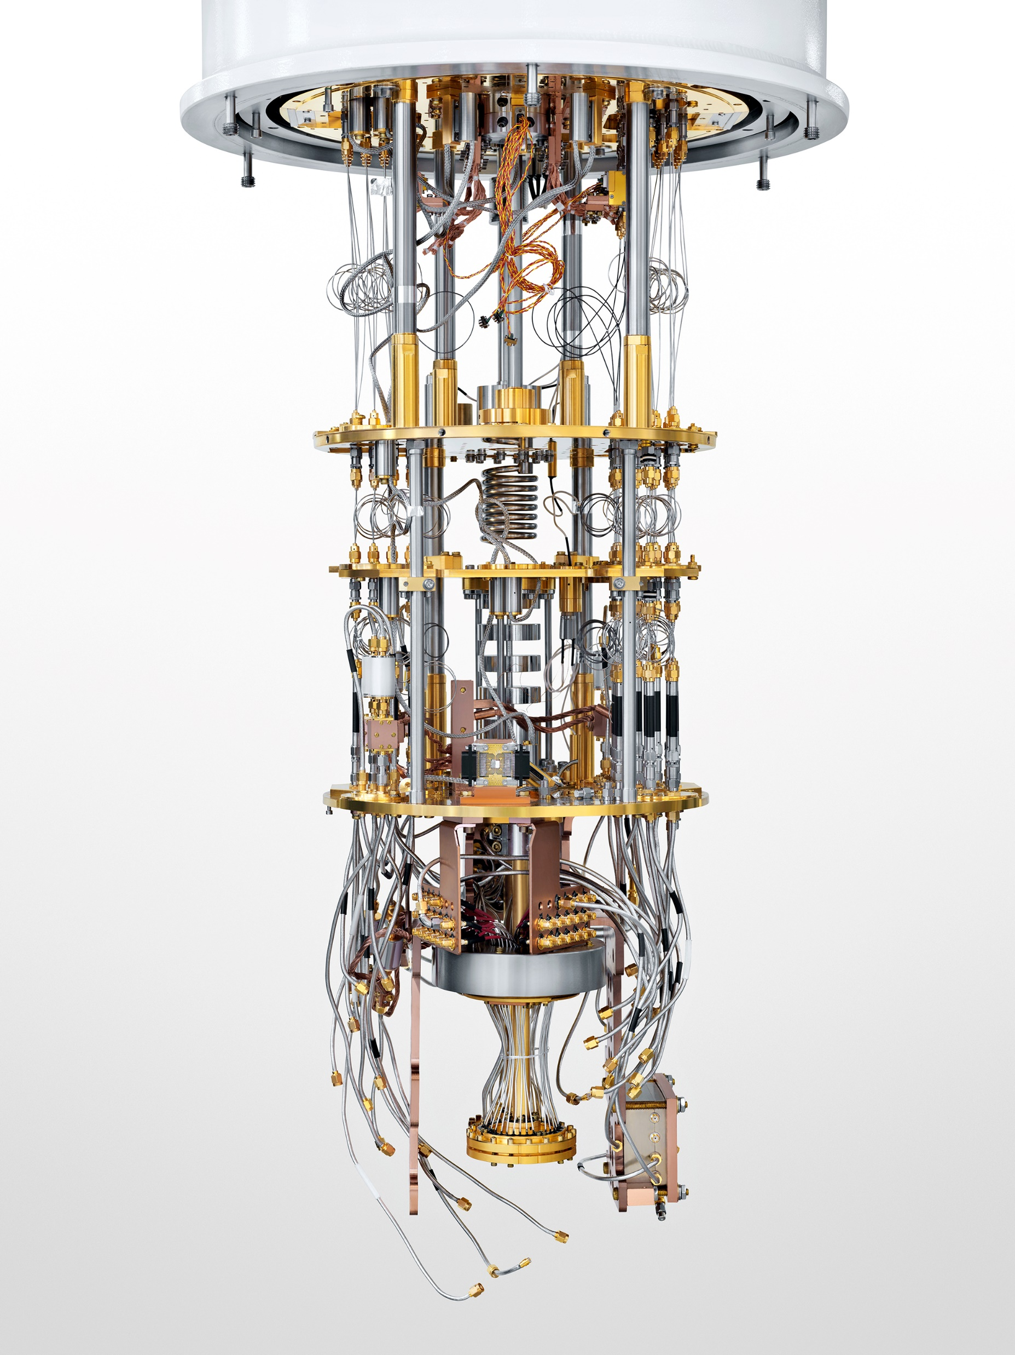
Quantum Pathways: Workshop on Quantum Information Science and Engineering
Partly supported by NSF: CyberTraining: Pilot: Quantum Research Workforce Development on End-to-End Quantum Systems Integration
Research Path from Classical Computing to Quantum Computing
CPU/GPU/FPGA
QC
Weiwen Jiang, Ph.D.
Assistant Professor
Electrical and Computer Engineering
George Mason University
wjiang8@gmu.edu
https://jqub.ece.gmu.edu

Slide 3
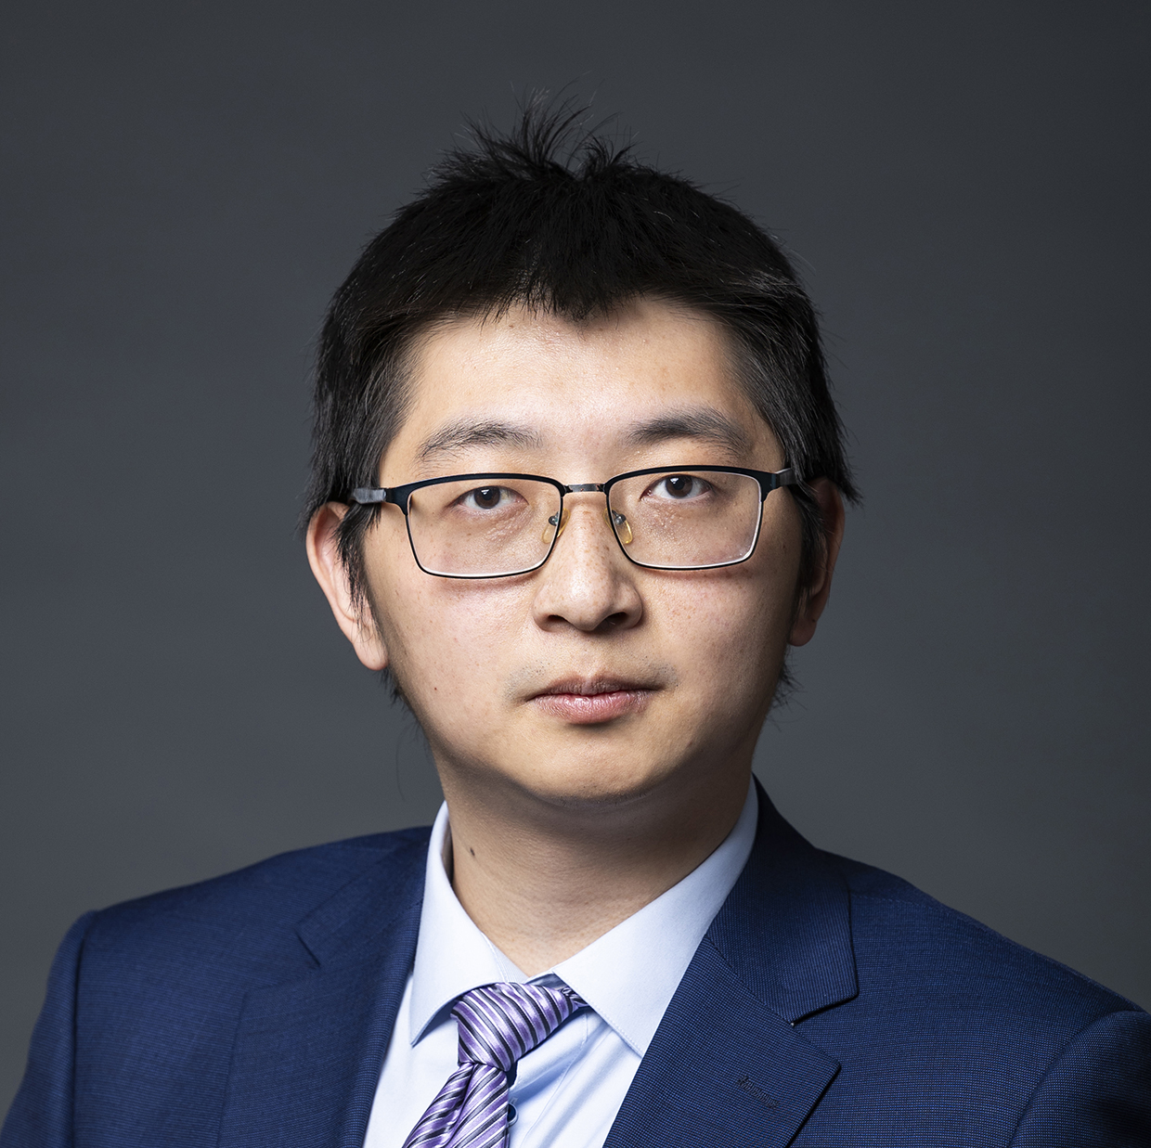

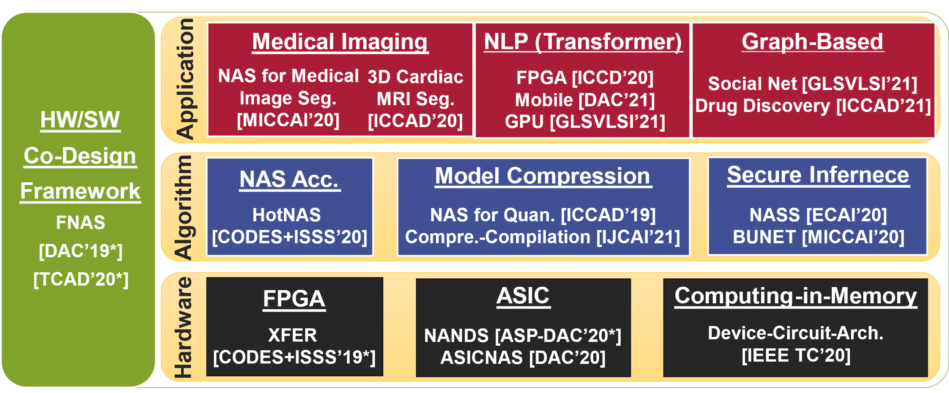



Speaker
Education Background
Chongqing University (2013-2019)
University of Pittsburgh (2017-2019)
University of Notre Dame (2019-2021)
Research Interests
Optimization
HW/SW Co-Design
Quantum Learning
Weiwen Jiang
Assistant Professor
Electrical and Computer Engineering (ECE)
George Mason University
Room3247, Nguyen Engineering Building
wjiang8@gmu.edu
(703)-993-5083
https://jqub.ece.gmu.edu/
First HW/SW Co-Design Framework using NAS
Best Paper
Award:
Best Paper
Nominations:

Slide 4

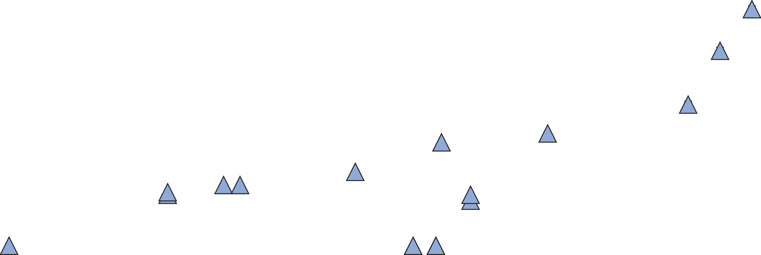
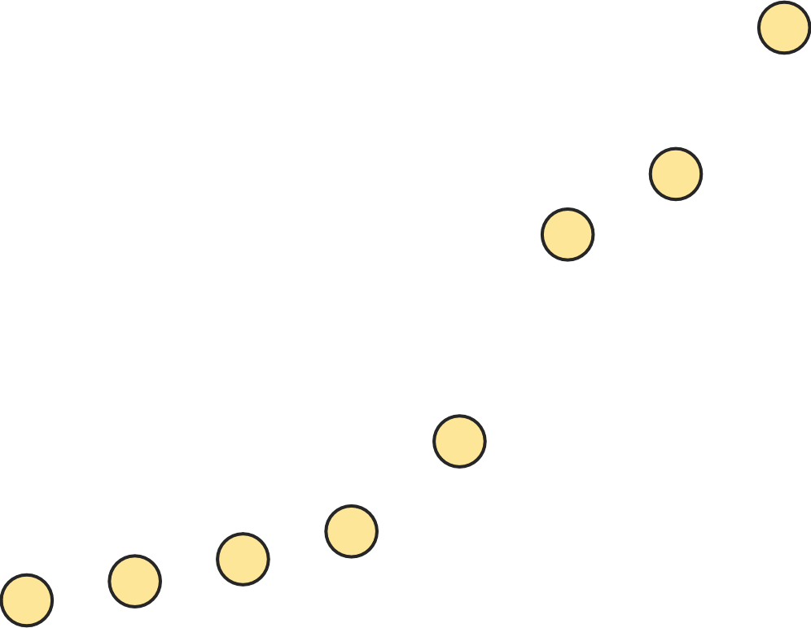


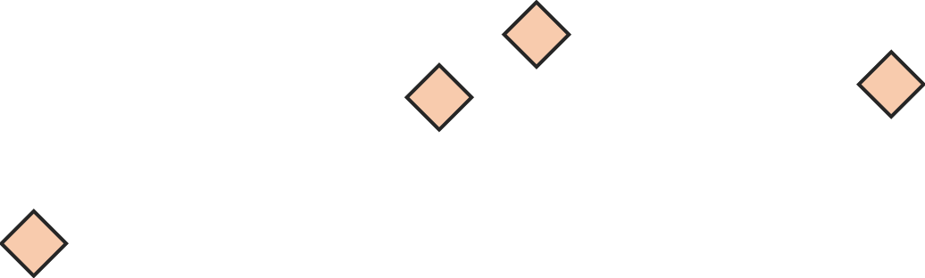
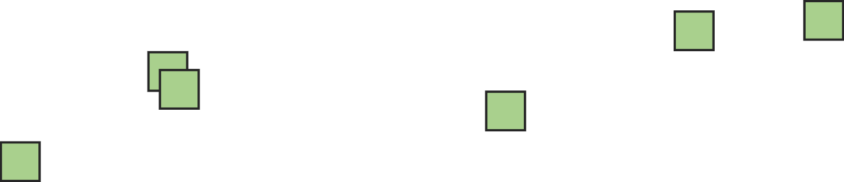
Research Path was Shifting along with the Growth of Quantum
2
Condor Processor
(1121 Qubits)
Dec. 4, 2023
0
4
8
1
0
2
4
5
1
2
2
5
6
1
2
8
6
4
3
2
1
6
8
4
Optimization
Research
Task Mapping
2
HW/SW Co-Design
ML Accelerator
1
Quantum
2
0
2
2
2
6
4
2
0
2
04/
0
8
2
0
1
5
05
2
0
1
6
06
2
0
1
7
07
2
0
1
8
08
2
0
1
9
09
2
0
2
0
10/
2
0
2
/
/
/
/
/
1
Why?
Why?

Slide 5
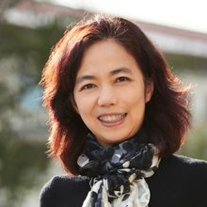
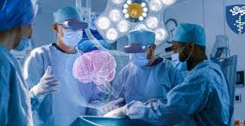
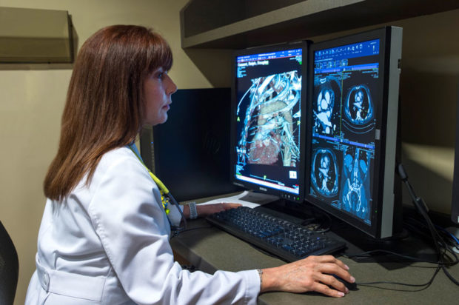
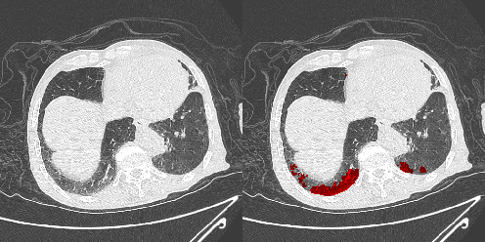
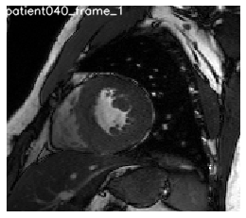
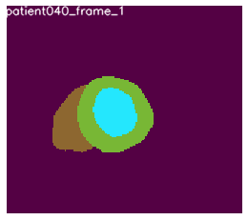

What is Classical AI Democratization & What is the Challenge?
“It’s here to collaborate, to augment, to enhance human lives and productivity and make everybody's life better. And related to that, is to democratize A.I. in a way that everybody gets benefit. Not just a few, or a selected group.” Fei-Fei Li, 2017
Medical AI Scenario
AI Can Perform Medical Tasks
AR/VR in Surgery
Medical Diagnosis
COVID CT Segmentation
Real-Time MRI Segmentation
Let Doctors Design Neural Networks?

Slide 6
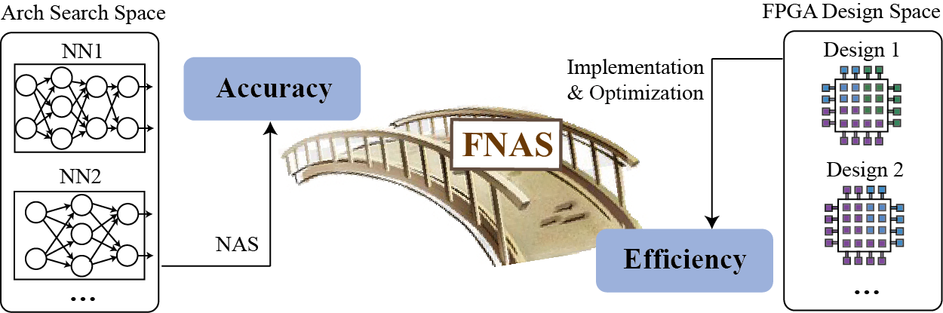
Progress of Classical AI Democratization
Google’s Initial Contributions
(Neural Architecture Search)
Our Contributions
(Network-Accelerator Co-Design)
Given:
Dataset
Given:
(1) Dataset; (2) Target hardware, e.g., FPGA.
Objective:
Automated search for NN (w/o human)
Maximize accuracy on the given dataset
Objective:
Automated search for NN and HW design
Maximize accuracy on the given dataset
Maximize hardware efficiency
Output:
A neural network architecture
Output:
A pair of neural network and hardware design
Sample architecture NN with probability p
Controller (RNN)
Train NN to obtain accuracy A
FNAS
Compute gradient of p and scale it by A to update the controller
[ref] Jiang, Weiwen, et al. "Accuracy vs. efficiency: Achieving both through fpga-implementation aware neural architecture search." DAC 2019. (BEST PAPER NOMINATION)
[ref] Jiang, Weiwen, et al. “Hardware/software co-exploration of neural architectures”, TCAD 2020 (BEST PAPER AWARD)
[ref] Zoph, Barret, and Quoc V. Le. "Neural architecture search with reinforcement learning." ICLR 2017

Slide 7

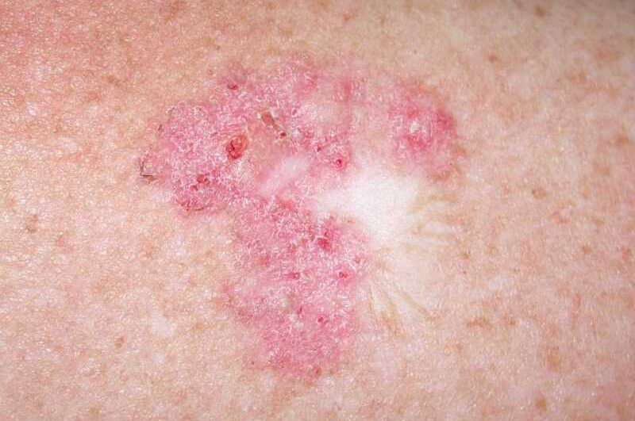

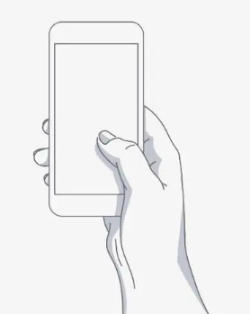
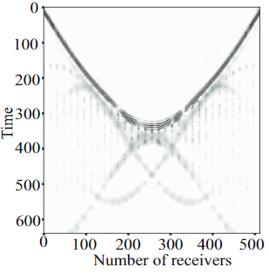
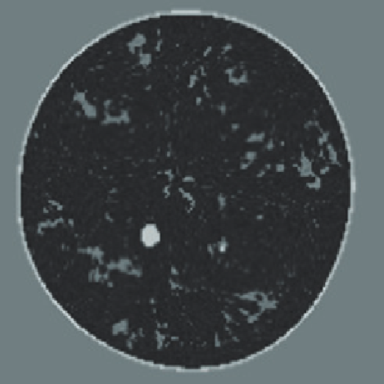
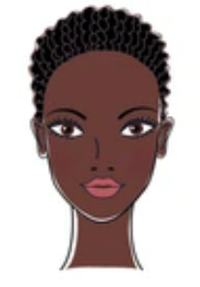
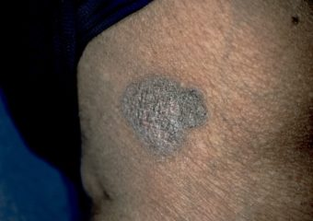
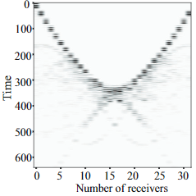
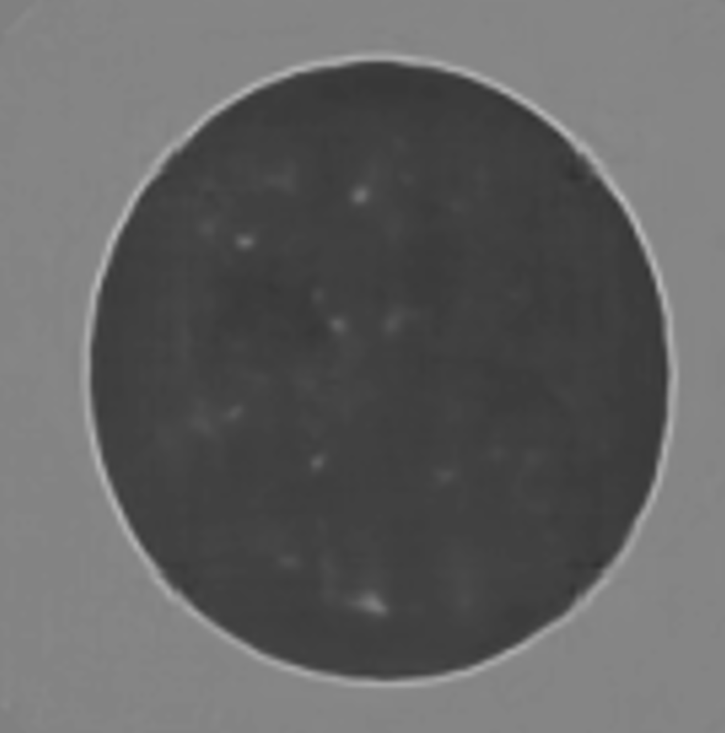
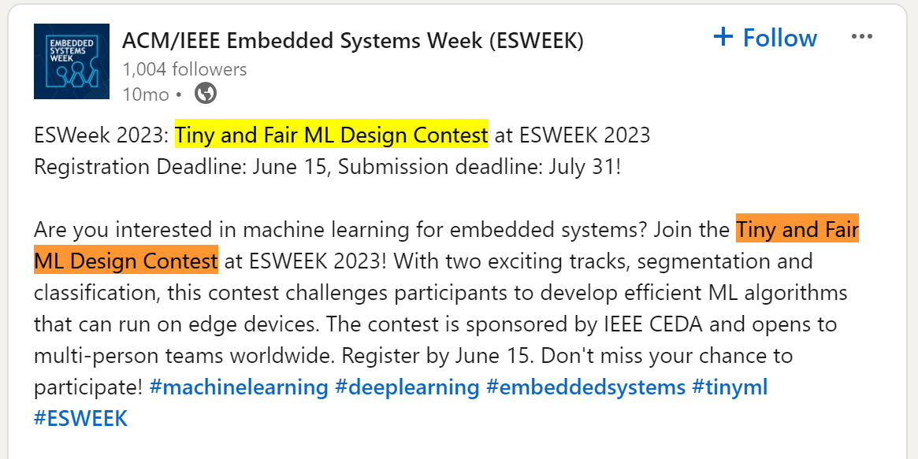
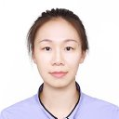
On-Going Research: System-Support AI for Science
NSF 2027539: RAPID: Collaborative Research: Independent Component Analysis Inspired Statistical Neural Networks for 3D CT Scan Based Edge Screening of COVID-19. ($98,349 in total, Co-PI with share $49,174)
Problem and Challenge
Problem: Ultrasound CT Scan
Light Skin
81.56%
Forward Modeling
Physics Approach
Dark Skin
50.62%
Data Driven
Neural Network
Different skin Tones
Solutions
The Larger The Fairer? Small Neural Networks Can Achieve Fairness for Edge Devices --- DAC 2022
Ensemble Learning for Multi-Dimension AI Fairness --- DAC 2023
ViT-CNN for AI fairness --- ICCAD 2023
Challenge: Sparse data in USCT
Data Driven
Neural Network
Community building: Chair and Create ML Contest at ESWEEK’23
2 Tracks
72 Teams
702 Submissions
6 Winners
Student
Solution:
Physics-guided AI for co-optimize model and data --- Submitted to MICCAI
My first Ph.D. student, Yi Sheng.
Estimate graduation: Spring 2025
Notes:
In the following slides, I will show you some of my current research. The research in this slides is carried out by my first PhD student. She will be on job market this fall for a faculty position. Let’s see what she explored during her PhD.
As you can see in the slides, the problem we target is the fairness issue for the on-device AI. Specifically, when we apply AI for skin disease diagnose, it shows the bias on people with different skin color, as shown in the slides.
In past two years, we proposed to use neural architecture search to find the neural architecture for high accuracy, fairness and timing performance.
We also want to bring people to conduct research on this important field. In last year, I chaired and crated the first Tiny and Fair ML design contest at ESWEEK. It received a large number of participation. (click)
Now, we are exploring a more challenging medical AI problem. As shown in the slides, we are using the ultrasound wave information to reconstruct the structure under skin. The physics approach can solve the forward problem that is using the structure to generate the wave.
But the problem of using waveform for reconstruction is much more challenging, since we only have data outside of our skin.
The problem becomes more challenge when we reduce the number of receivers to control cost. As shown in the slides, the straightforward reconstruction using sparse data has very low performance.
We are exploring the physics-guided AI to co-optimize the model and data, and we have received encourage results. The work will be submitted to MICCAI next week.

Slide 8
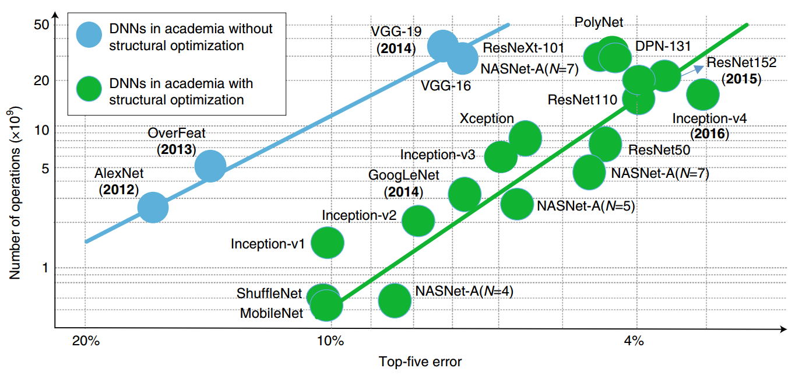
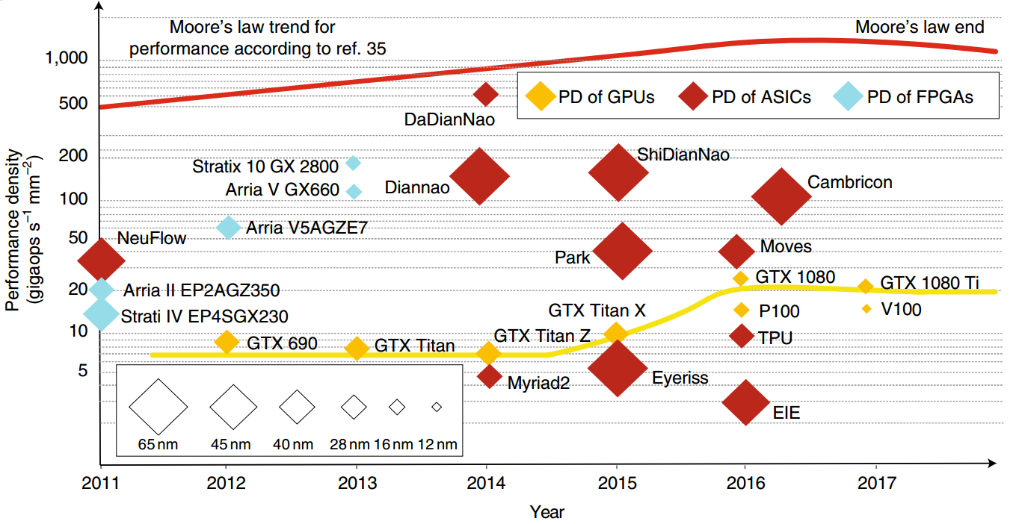
Bottlenecks in Classical Computing
Deep neural network grows exponentially
Perf. of classical computing stops increasing
Medical AI Scenario: (Input size exponentially grows from Radiology to Pathology Imaging)
Radiology Imaging
Pathology Imaging
Radiology Modality | Avg. Size (MB)
CT Scan | 153.4
MRI | 98.6
X-ray angiography | 157.5
Ultrasound | 69.2
Breast imaging | 38.8
Biopsy Type | Compressed Size(MB)/Study | Original Size (GB)
Dermatopathology | 1,392 (20x compression) | 27
Head and neck | 1,965 (20x compression) | 38
Hematopathology | 40,300 (40x compression) | 1574
Neuropathology | 1,872 (20x compression) | 37
Thoracic pathology | 3,240 (20x compression) | 63
[ref] Lauro, Gonzalo Romero, et al. "Digital pathology consultations—a new era in digital imaging, challenges and practical applications." Journal of digital imaging 26.4 (2013).

Slide 9
Outline
Optimization
Research
Task Mapping
HW/SW Co-Design
ML Accelerator
Background and Challenge in Classical Computing
Potential of Quantum Computing
Tasks Impossible for Classical Computing
Today’s Quantum Computers
Research on Quantum Computing @ JQub
Performance, Stability, and Reliability
Domain-specific Quantum Computing
Messages to Send
HW/SW Co-Design
ML Accelerator
Quantum

Slide 10
Potential: Tasks Impossible for Classical Computing
2
Condor Processor
(1121 Qubits)
Dec. 4, 2023
0
4
8
1
0
2
4
5
1
2
2
5
6
1
Quantum Utility
2
8
6
4
3
2
47 qubits
1
6
8
The capacity of Classical Simulation
4
2
1
2
0
2
2
2
6
4
2
0
2
04/
0
8
2
0
1
5
05
2
0
1
6
06
2
0
1
7
07
2
0
1
8
08
2
0
1
9
09
2
0
2
0
10/
2
0
2
/
/
/
/
/
1
The maximum qubits that supercomputers can simulate for arbitrary circuits is less than 47 qubits.
Summit w/ 2.8 PB memory for 47 qubits; (2) Sierra w/ 1.38 PB memory for 46 qubits;
(3) Sunway TaihuLight w/ 1.31 PB memory for 46 qubits; (4) Theta w/ 0.8 PB memory for 45 qubits.
[ref] Wu, Xin-Chuan, et al. "Full-state quantum circuit simulation by using data compression." Proceedings of the International Conference for High Performance Computing, Networking, Storage and Analysis. 2019.

Slide 11
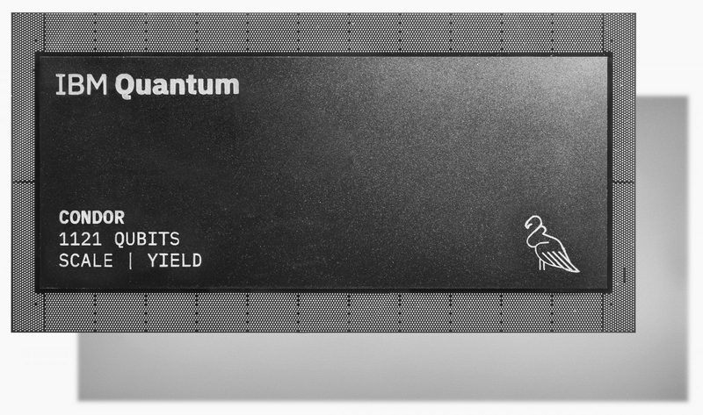
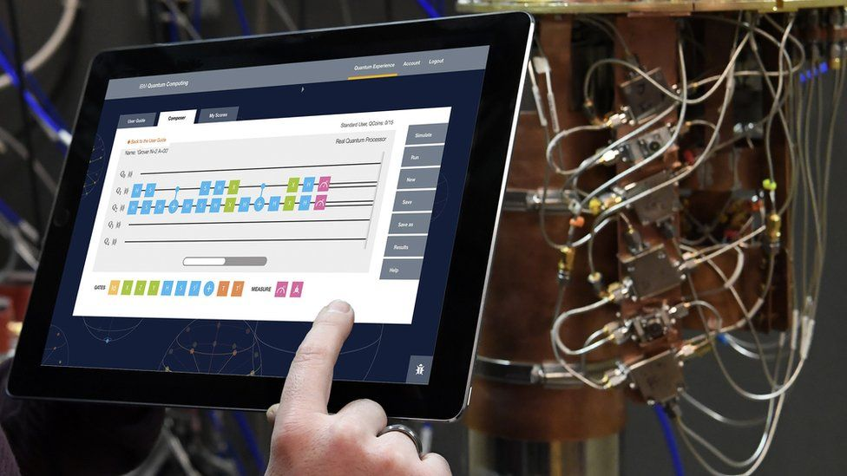
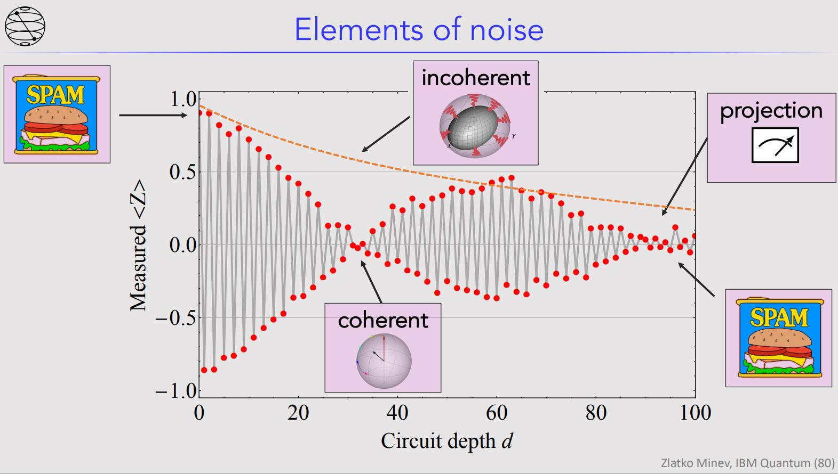
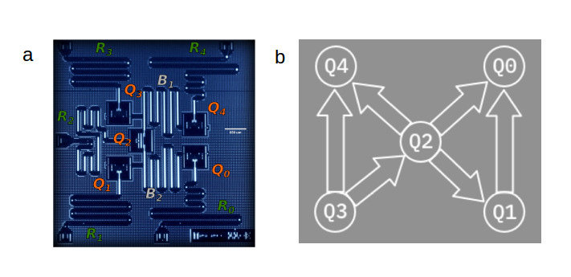
What’s the Status of Today’s Quantum Computers? Let’s See What Happen at IBM Quantum Summit 2023 (Dec 4, 2023)
NISQ Era @ 2017
Era of Utility @ 2023

Slide 12
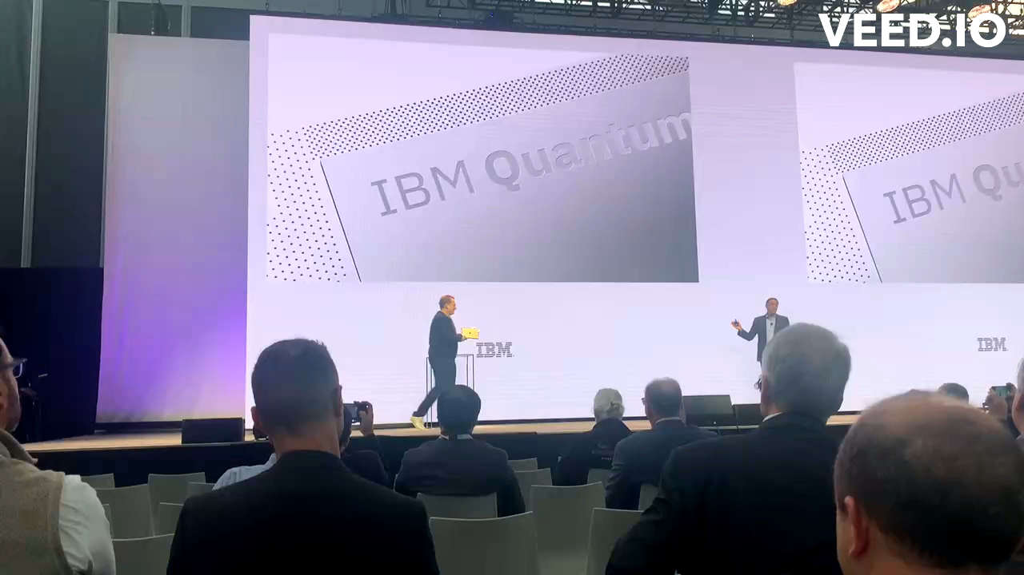
What’s the Status of Today’s Quantum Computers? Let’s see what Happen at IBM Quantum Summit 2023 (Dec 4, 2023)

Slide 13

What’s the Status of Today’s Quantum Computers? What is the Meaning by Quantum Utility --- From IBM Quantum Summit
The Era of Utility means a focus on performance, stability and reliability
The Era of Utility means new users, and new tools
QC Scientist
QC

Slide 14
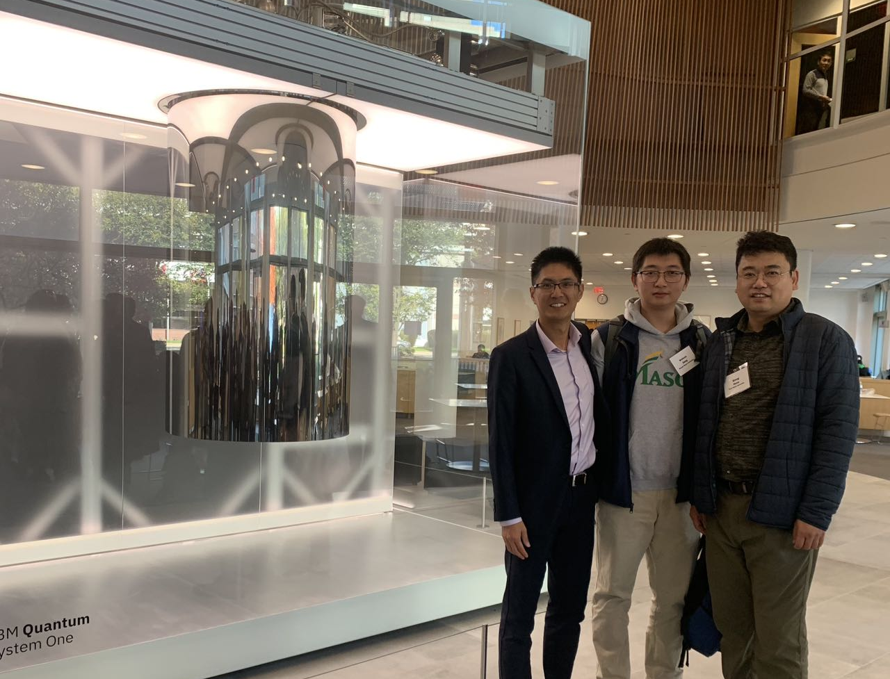
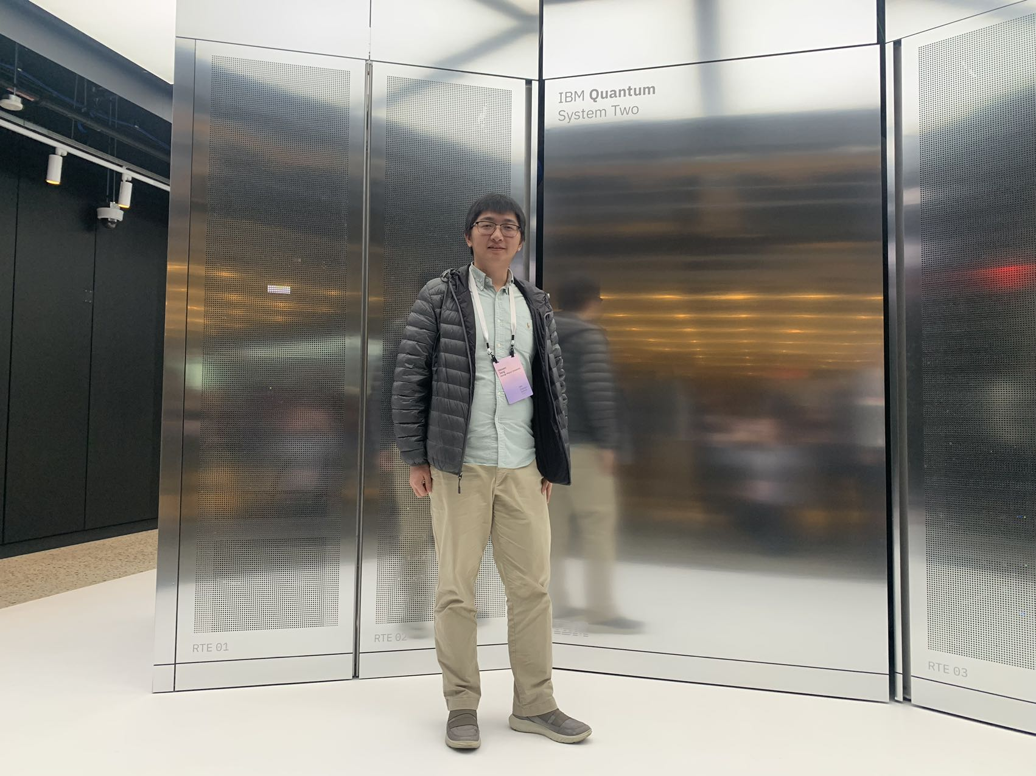
Takeaway
Quantum Utility Era is now coming
Performance, stability, and reliability are keys to achieve Quantum Utility
Domain users are expected to use quantum computers
IBM Quantum System I
Junction of Quantum-Classical Computer-Aided Design Lab
(JQub)
Let Doctors Design Neural Networks?
Let Doctors Learn Quantum Computing?
IBM Quantum System II

Slide 15
Outline
Background and Challenge in Classical Computing
Potential of Quantum Computing
Tasks Impossible for Classical Computing
Today’s Quantum Computers
Research on Quantum Computing @ JQub
Performance, Stability, and Reliability
Domain-specific Quantum Computing
Messages to Send

Slide 16
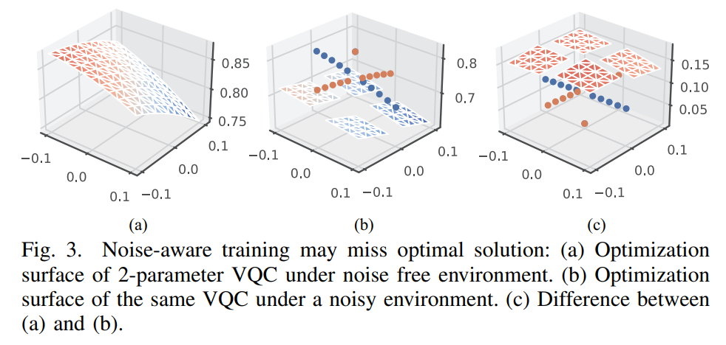
Noise Changes the Optimization Surface
Ref: Zlatko K. Minev, IBM Quantum
Our Observation:
Insight:
Shorter circuit has higher fidelity.
Question:
What are the breakpoints in the noisy optimization landscape?
Notes:
My first work is quantum neural network compression. The first problem is why we do compression in QNN.

Slide 17
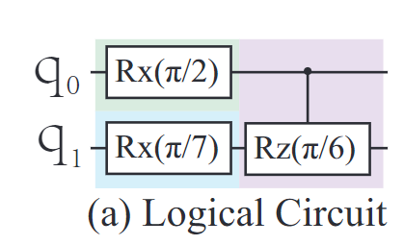
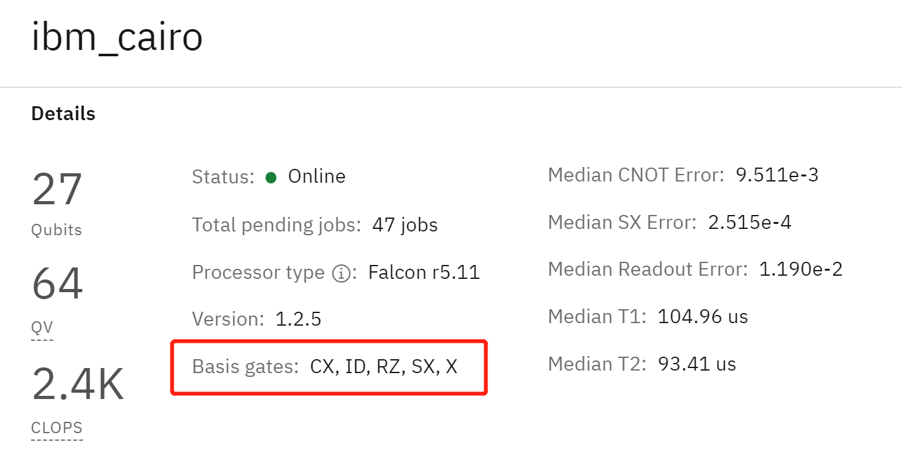
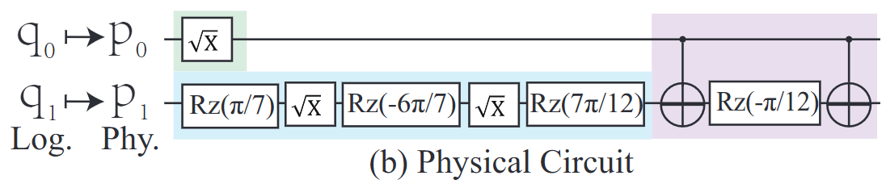
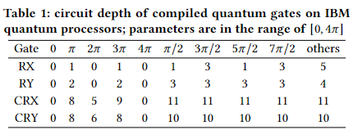
Motivation: Parameters Affect Circuit Length through Compilation
Breakpoints?

Slide 18

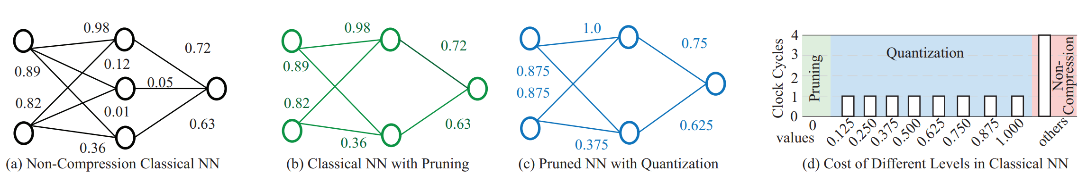
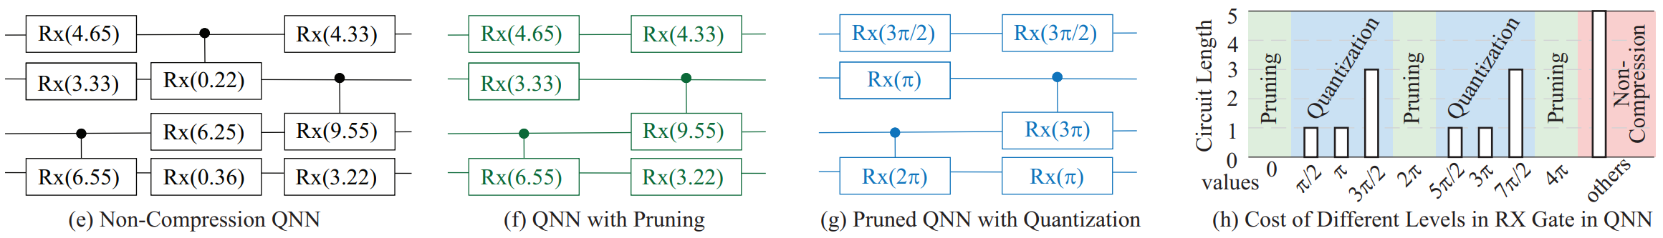
Quantum Neural Network Compression @ ICCAD’2022
Model compression in Classical ML is to improve hardware efficiency
Model compression in Quantum ML can reduce circuit length, and thus, further provide high fidelity

Slide 19
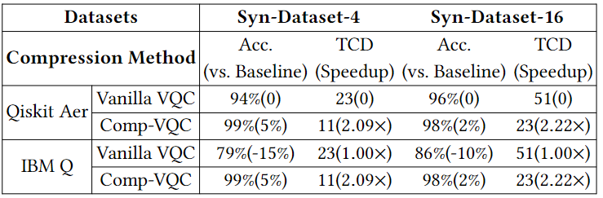
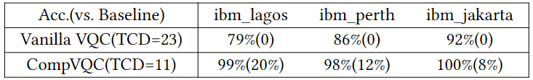
CompVQC Framework: Experiment Results
CompVQC can reduce circuit length by 2X
The accuracy is higher in a noisy environment
Insights:
CompVQC can improve robustness of QNN
CompVQC is not aware of noise

Slide 20
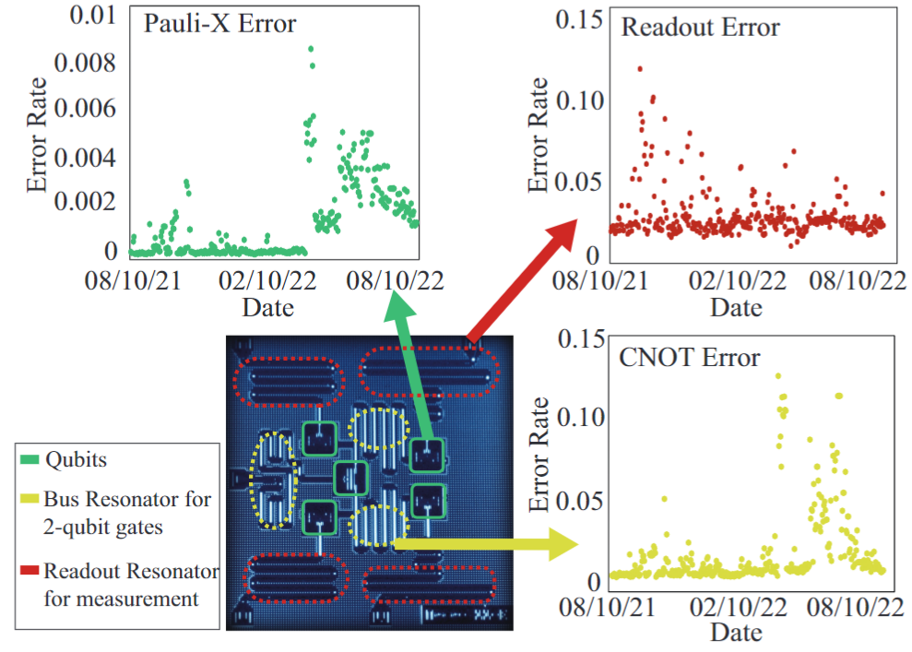
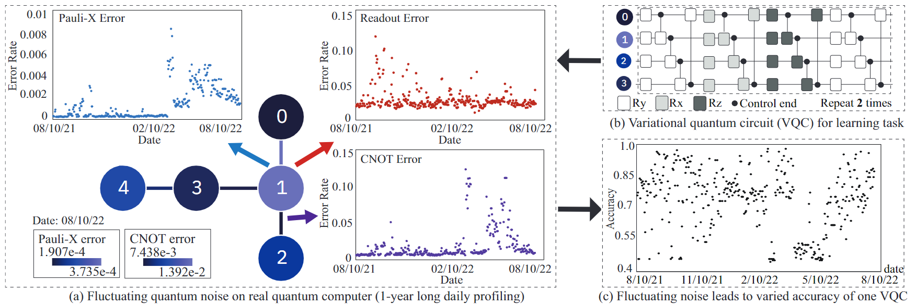
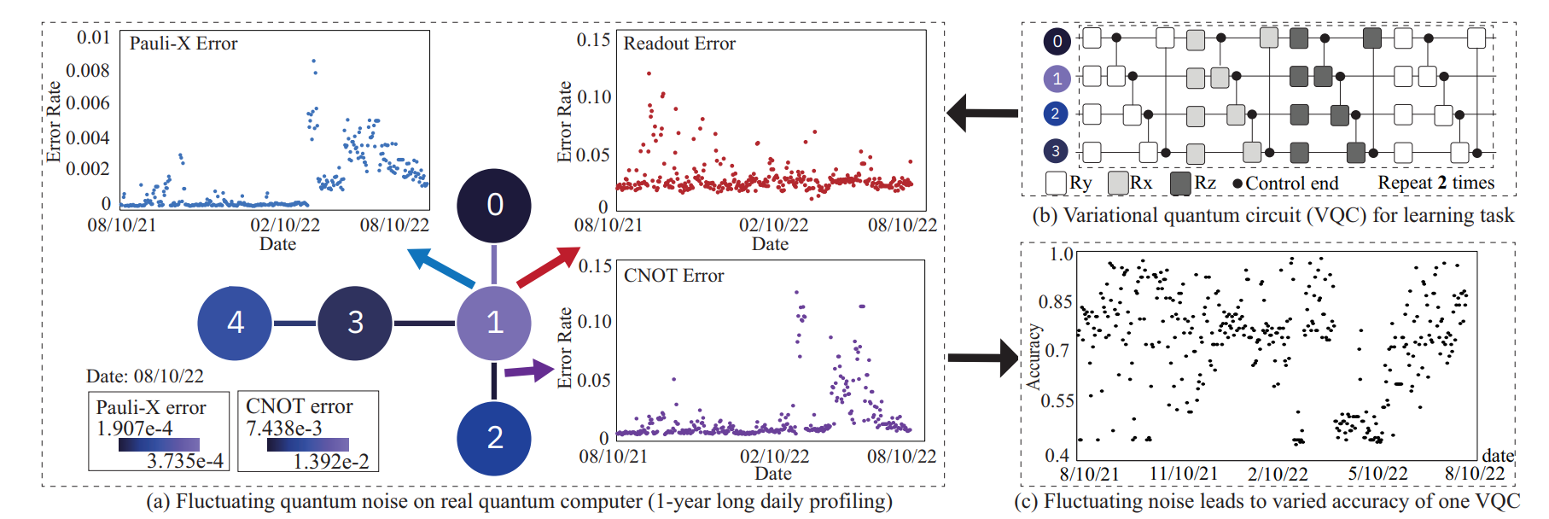
Unstable Quantum Noise Leads to Performance Changes
Insight:
Temporal reproducibility or reliability of a quantum learning model.
Users may not be aware of the performance changes.

Slide 21

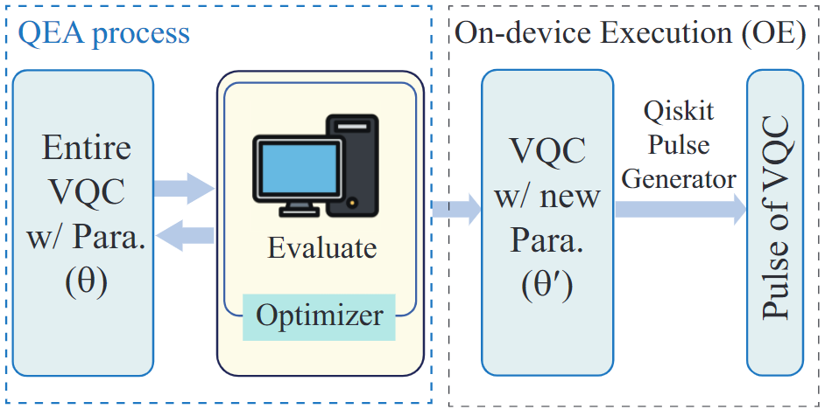
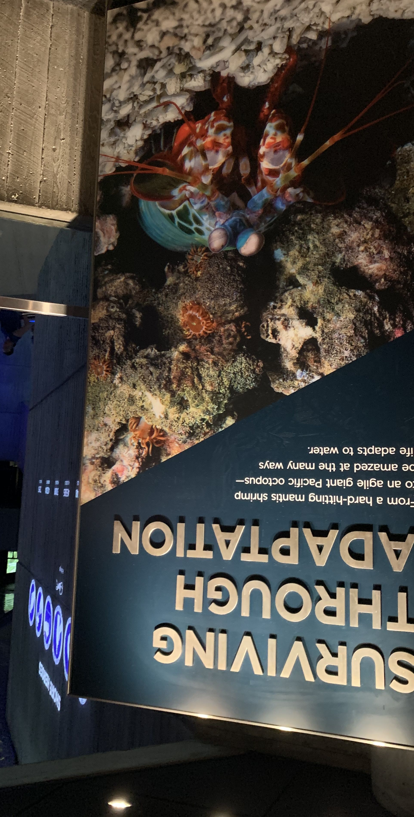
Quantum Error Adaptation @ DAC 2023
Notes:
Aquarium Srimp Environment

Slide 22
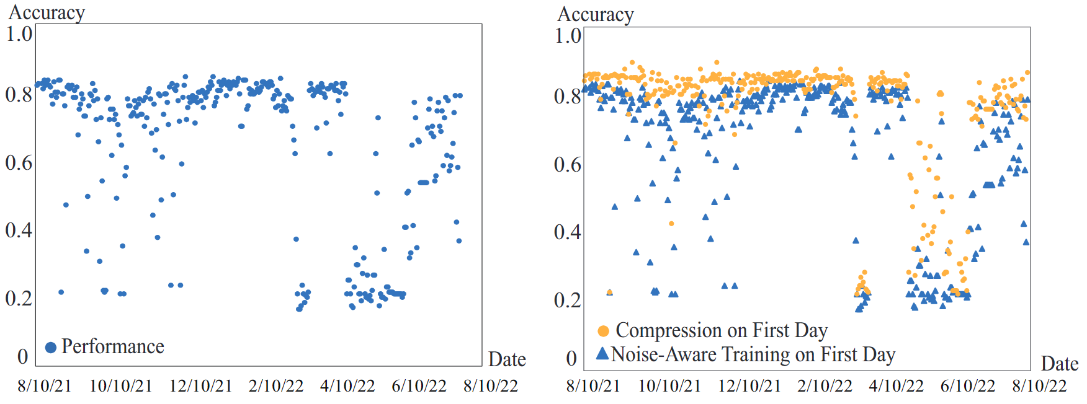
Fluctuating Quantum Noise
Observation: Fluctuating noise can collapse the model accuracy of a noise-aware trained QNN model
Observation: Compression can boost the performance of QNN than noise-aware training, but not enough
The accuracy of QNN on 4-class MNIST from August 2021 to August 2022 on IBM backend belem using Qiskit Simulation.
Notes:
TODO: Noise

Slide 23

Battle Against Fluctuating Quantum Noise
Observation: Models Compressed on one noise level have different performance on different days
Observation: Models Compressed on different noise levels (dates) have different performance on the same day
① Noise aware compression ② Model Repository
Notes:
TODO: Noise

Slide 24

Battle Against Fluctuating Quantum Noise
Solution: Offline + Online
Offline:
Use historic data to construct a repository by clustering
Online:
Select a model to do inference
Maintain the repository: whether to generate new models into the model repository manager
Notes:
TODO: Noise

Slide 25

QuCAD: Experiment Results
Significantly improve the number of days for the desired accuracy
CompVQC
Accuracy > 80% (146 days in total)
MINST: 24 -> 100
Iris: 0 -> 84
Seismic wave: 18 -> 133
Accuracy > 70% (146 days in total)
MINST: 93 -> 134
Iris: 0 -> 108
Seismic wave: 70 -> 146
Notes:
TODO: Noise

Slide 26
Outline
Background and Challenge in Classical Computing
Potential of Quantum Computing
Tasks Impossible for Classical Computing
Today’s Quantum Computers
Research on Quantum Computing @ JQub
Performance, Stability, and Reliability
Domain-specific Quantum Computing
Messages to Send

Slide 27



Quantum Learning for Geophysics @ DAC 2024

Slide 28
Outline
Background and Challenge in Classical Computing
Potential of Quantum Computing
Tasks Impossible for Classical Computing
Today’s Quantum Computers
Research on Quantum Computing @ JQub
Performance, Stability, and Reliability
Domain-specific Quantum Computing
Messages to Send

Slide 29




Messages
Research directions are NOT independent but entangled
e.g., model compression from Classical ML to Quantum ML
CS/CpE students CAN significantly contribute to Quantum Computing
How to Take First step? Online Tools and Tutorials!
Quirk visible simulator
https://algassert.com/quirk
Our Contribution:
VACSEN Noisy QC
https://vacsensystem.github.io/
Our Contribution:
QuantumFlow Tutorial
https://jqub.ece.gmu.edu/categories/QF/

Slide 30




















Acknowledge
Academia Students and Collaborators
National Lab
Sponsors:
OAC-2311949: An Integrated Framework for Enabling Temporal-Reliable Quantum Learning on NISQ-era Devices
OAC-2320957: CyberTraining: Pilot: Quantum Research Workforce Development on End-to-End Quantum Systems Integration

Slide 31
Reference
[1] Zhirui Hu, Peiyan Dong, Zhepeng Wang, Youzuo Lin, Yanzhi Wang, Weiwen Jiang, Quantum Neural Network Compression, In Proceedings of the 41st IEEE/ACM International Conference on Computer-Aided Design (ICCAD), 2022.
[2] Zhirui Hu, Youzuo Lin, Qiang Guan, Weiwen Jiang, Battle Against Fluctuating Quantum Noise: Compression-Aided Framework to Enable Robust Quantum Neural Network, In Proceedings of Design Automation Conference (DAC), 2023.
[3] W. Jiang, J. Xiong, and Y. Shi, A Co-Design Framework of Neural Networks and Quantum Circuits Towards Quantum Advantage, Nature Communications, 12, 579, 2021.
[4] Z. Wang, Z. Liang, S. Zhou, C. Ding, J. Xiong, Y. Shi, W. Jiang, Exploration of Quantum Neural Architecture by Mixing Quantum Neuron Designs, IEEE/ACM International Conference On Computer-Aided Design (ICCAD), 2021.
[5] Z. Liang, Z. Wang, J. Yang, L. Yang, J. Xiong, Y. Shi, W. Jiang, Can Noise on Qubits Be Learned in Quantum Neural Network? A Case Study on QuantumFlow, IEEE/ACM International Conference On Computer-Aided Design (ICCAD), 2021.
[6] W. Jiang, J. Xiong, and Y. Shi, When Machine Learning Meets Quantum Computers: A Case Study, in Proc. of Asia and South Pacific Design Automation Conference (ASP-DAC), 2021.
[7] Zhiding Liang, Hanrui Wang, Jinglei Cheng, Yongshan Ding, Hang Ren, Zhengqi Gao, Zhirui Hu, Duane S. Boning, Xuehai Qian, Song Han, Weiwen Jiang, Yiyu Shi, Variational Quantum Pulse Learning, In 2022 IEEE International Conference on Quantum Computing and Engineering (QCE), pp. 556-565. IEEE, 2022.
[8] Shaolun Ruan, Yong Wang, Weiwen Jiang, Ying Mao, Qiang Guan, VACSEN: A Visualization Approach for Noise Awareness in Quantum Computing, IEEE Transactions on Visualization and Computer Graphics (VIS), 2022.
[9] Shaolun Ruan, Ribo Yuan, Yong Wang, Yanna Lin, Ying Mao, Weiwen Jiang, Zhepeng Wang, Wei Xu, Qiang Guan, Venus: A geometrical representation for quantum state visualization, EuroVis20, 2023.
[10] Hanrui Wang, Zhiding Liang, Jiaqi Gu, Zirui Li, Yongshan Ding, Weiwen Jiang, Yiyu Shi, David Z Pan, Frederic T Chong, Song Han,TorchQuantum Case Study for Robust Quantum Circuits, IEEE/ACM International Conference On Computer-Aided Design (ICCAD), 2022.

Slide 32
Reference
[11] W Jiang, Y Lin, QuGeo: An End-to-end Quantum Learning Framework for Geoscience--A Case Study on Full-Waveform Inversion, Accepted by DAC 2024.
[12] Z Hu, R Wolle, M Tian, Q Guan, T Humble, W Jiang, Toward Consistent High-fidelity Quantum Learning on Unstable Devices via Efficient In-situ Calibration, QuantumWEEK 2023 (Best Paper Award)
[13] J Li, Z Wang, Z Hu, A Li, W Jiang, A novel spatial-temporal variational quantum circuit to enable deep learning on nisq devices, QuantumWEEK 2023
[14] J Li, Q Guan, D Tao, W Jiang, Carbon Emissions of Quantum Circuit Simulation: More than You Would Think, IGSC 2023
[15] Z Wang, J Li, Z Hu, B Gage, E Iwasawa, W Jiang, QuMoS: A Framework for Preserving Security of Quantum Machine Learning Model, QuantumWEEK 2023

Slide 33
wjiang8@gmu.edu
George Mason University
4400 University Drive Fairfax, Virginia 22030
Tel: (703)993-1000

Slide 34



Co-Design Stack of Neural “Architectures”
What is the best Neural Network Architecture for FPGAs
Model optimization (pruning and quantization)?
Network exploration
NAS
(Google)
……
Co-Design
Framework
(e.g., Our
FNAS)
Co-Design
Network compression
Deep Comp
(Stanford)
Library
Programming library
DNNBuilder
(UIUC)
……
Hardware accelerator
DNN on FPGA
(UCLA)
Mapping and scheduling?
What is the best FPGA Architecture for neural networks

Slide 35






Current Research: AI-Support Quantum System Optimization
NSF 2311949: Collaborative Research: OAC Core: An Integrated Framework for Enabling Temporal-Reliable Quantum Learning on NISQ-era Devices. 2023 – 2026. ($600k in total, Lead PI with share $330k)
Problem and Challenge
Solution 1: Quantum neural network compression
Solution 2: Online adaptation based on offline unsupervised learning
Community building
Passive Adaptation
Established the First Quantum Stability Workshop (StableQ)
Travis S Humble
ORNL
DoE QSC
Speakers from NSF, ORNL, PNNL, IBM, IonQ, Zapata, MIT, ICL, JHU, etc.
Over 80-person times.
Active Adaptation
Solution 3: On-the-fly lightweight calibration
Notes:
Now, I am going to talk how to make such theoretically good results on the real quantum device. The problem that makes troubles for every quantum computing researcher is the high noise level. What’s more, we observe the noise is not stable. As shown in this figure, we give the daily noise on IBM quantum computer for different quantum operators. The x-axis is the dates, and y-axis is the noise level. It is clear that the noise changed sharply. As a result, when we deploy a trained quantum learning model to process the same data on the device at different days. We can see the accuracy ranges from 40% to 90%. To solve this issue, the straightforward way is to improve the circuit fidelity. (click)
We observe that the fidelity is affected by the circuit depth, and therefore, our first work borrowed the widely used model compression from AI domain to compress the quantum neural network. It can improve the circuit fidelity, but cannot fundamentally address the unstable noise issue. (click)
In DAC last year, we propose the quantum circuit adaptation during the deployment stage. We use the offline unsupervised learning to cluster the noise and optimize a circuit for each cluster. At online stage, we match the current noise with the clusters and use the corresponding circuit for execution. This can significantly improve the stability. We call such method as passive adaptation, since we only change our circuit design and not directly improve the gate fidelity. (click)
In IEEE Quantum Week last year, we propose a lightweight calibration to optimize the pulse control parameters before running the circuit, so that we can further improve the performance. This work obtained the best paper award. (click)
We also want to emphasize the importance of the stability issue in the community, and I collaborated with Travis Humble from oakridge national lab to established the stableQ workshop, where we have a good number of attendance.

Slide 36

What’s the Problem for NISQ Quantum?
When NISQ Proposed
Condor
(1121 qubits)
Today’s Utility era by IBM Heron
(133 qubits)
10 Year Later in IBM’s new Roadmap
Unknown

Slide 37


Co-Design of Neural Networks and Quantum Circuit
What is the best Neural Network Architecture for QC?
Can we compress the quantum neural network?
Network exploration
QF-Mixer
……
Co-Design
Framework
QuantumFlow
Network compression
CompVQC
Co-Design
Library
Programming library
QFNN
……
Device-aware design
QF-RobustNN
……
U(W)
???
U(N)
What is the best QC design for neural networks?
+

Slide 38
Fundamental Similarities
Classical ML
Quantum ML
Network exploration
NAS
(Google)
Network exploration
QF-Mixer
Co-Design
Framework
(e.g., Our
FNAS)
Co-Design
Framework
QuantumFlow
Network compression
Deep Comp
(Stanford)
Network compression
CompVQC
Programming library
DNNBuilder
(UIUC)
Programming library
QFNN
Hardware accelerator
DNN on FPGA
(UCLA)
Device-aware design
QF-RobustNN

Slide 39
Neural Network Compression: Classical vs. Quantum
Pruning and Quantization in Classical ML
Pruning and Quantization in Quantum ML
November 2, 2022
Reduction on the compiled circuit length for more than 2X with <1% accuracy loss.

Slide 40


Session 2: QuantumFlow Co-Design Framework
Q
uantu
mFlow
https://www.nature.com/articles/s41467-020-20729-5
https://github.com/JQub/QuantumFlow_Tutorial
Correctly implement binary neuron on quantum computers.
Reduce complexity from O(n) in classical computers to O(polylog(n)) in quantum computers.
On MNIST, achieve same accuracy with a cost reduction of 10.85× over classical computers.

Slide 41

Session 4: VACSEN: A Visualization Tool for Noise in Quantum Computing
October 16, 2022
VACSEN introduces a novel visualization technique to achieve noise-aware quantum computing, detailed comparison on the filtered compiled circuit view, and user-friendly interaction to achieve better fidelity.

